Slide 1
E-Commerce Website
Shoe-Shopee
Created by Group G

Slide 2
We have created E-commerce website with the help of html, java script and css.
First we have Index page: In this page we created header with the help of Div class and used list for Navigation to connect with others pages. Then we added a video in div tag.
We have 6 Different page and one add to cart option.
On the index page we add some product’s images and customer can also these products in cart for this we used button tag and connect with add to cart option.
At the end we added our details like email, contact no and address with the help of image tags
In the footer we used logo and others page navigations and details in Footer tag.
We used only one external javascript file connects in different pages.

Slide 3
Category page
Second we have category page where we have three categories: Men, women and kids and we used drop down list for inserting these categories.
We are using same header and footer in all the pages.
Under categories and click on button of categories we have products.
These categories using hyperlinks for connecting these pages depends on customer’s choices.
These selected products validate in java script and showing alert that this item is already in your cart.
Every product have price and product id for easy to insert in to cart.

Slide 4
Contact us
In contact us page we used same header then we have created div class and attached the details of contacting.
Here customer can connect with us by call, email and we have provided address we used hyperlink and it will connect to direct calling or email portal.
Then we have a form which have 4 fields with validation of only characters in First and Last name.
In email we have validation for valid email address provide by customer if we entered wrong email then it will show an alert after clicking on submit button it will work with the help of event click function.
In the message customer can not put numbers, it only valid on characters.
In the validation part we used java script regular expression

Slide 5
About us
In this page we are providing information about us
We used same header and footer as previous pages then we used div tag.
Inside the div tag we used para tag for providing paragraphs.
We used Css for alignment of para tag and font and text size.
With the help of css we can do the designing part.
In the footer we have logo tag and hyperlink of others pages and at the very end part of the footer we used class tag for showing our team member’s name.

Slide 6
Sign up
In the Sign up page we used form validation for email and password.
Customer have to entered valid email format and password in limit of 7-14 characters with numbers.
For sign up and login it is for customers to login in to the website by their ids
In the validation part we used java script regular expression for email and password.
Then we have footer with the details of services hours and links.

Slide 7
Add to cart
Add to cart is for adding products in cart.
In this page we used button function with products after clicking on button function will call.
We used event listener in add to cart, that will work after clicking on button.
One or more products can add in the cart function.
After that we have created two button one for check ou and another on is clear cart.
In the cart customers can see the total price and details of the products those are added.

Slide 8
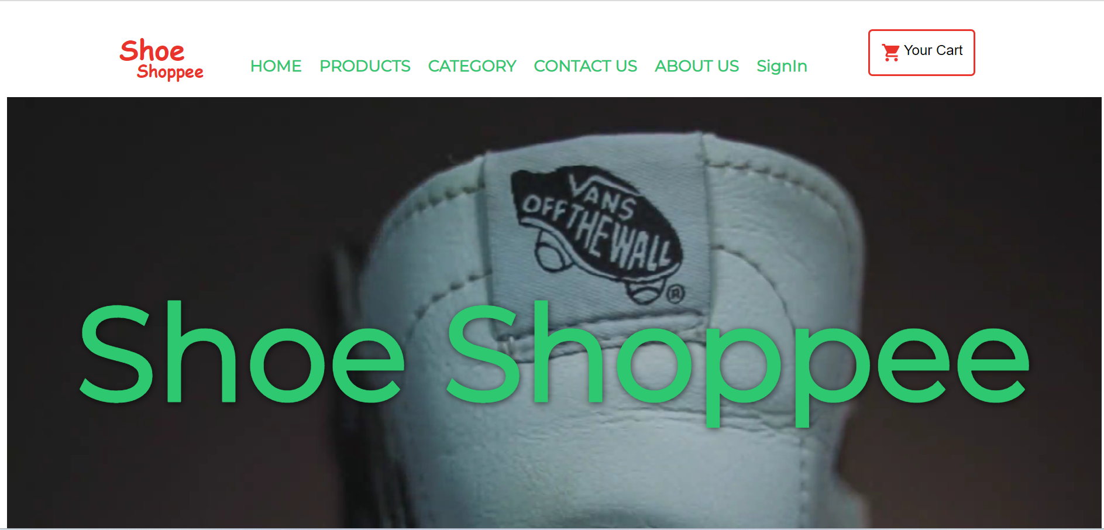

Thank you

